Slide 1
Understanding the Core Structure of a React Native CLI App
Chapter 14 - Understanding the Core Structure of a React Native CLI App

Slide 2
Understanding the Core Structure of a React Native CLI App
Core Structure of a React Native CLI App
We have already set up React Native for mobile application development
We learned that React Native depends on Node.js and several supporting packages
We also discovered that a helper tool like npx @react-native-community/cli init can be used to quickly scaffold a new project and begin development

Slide 3
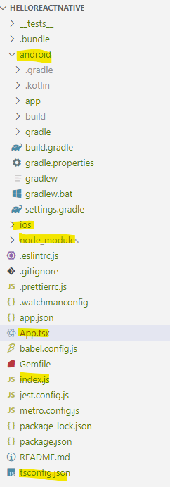
Understanding the Core Structure of a React Native CLI App
Core Structure of a React Native CLI App
Every React Native CLI application has the below folder structure
The main files we focus on are index.js and App.tsx, where index.js serves as the entry point of the application
The project includes a large set of node_modules, which are essential packages that support the design and execution of the app
It also contains platform-specific folders: android/ and ios/, which hold the native code needed to run the app on Android and iOS devices respectively

Slide 4
Understanding the Core Structure of a React Native CLI App
Core Structure of a React Native CLI App
1. index.js – Entry Point of the App
Acts as the starting point for your app
Registers the root component (in our case, App (App.tsx)) with the app name
This tells React Native to launch the App component when the app starts
import {AppRegistry} from 'react-native';
import App from './App';
import {name as appName} from './app.json';
AppRegistry.registerComponent(appName, () => App);

Slide 5
Understanding the Core Structure of a React Native CLI App
Core Structure of a React Native CLI App
2. App.tsx – Root Component
The main UI component of your app
This is where your app's logic and design begin
Displays a simple message centered on the screen
const App = () => {
return (
<View style={styles.container}>
<Text>Hello, React Native!</Text>
</View>
);
};

Slide 6
Understanding the Core Structure of a React Native CLI App
Core Structure of a React Native CLI App
3. node_modules/ – Dependencies Folder
Contains all the installed JavaScript packages your app needs
Automatically created when you create a React Native CLI application
This includes react, react-native, and any other packages your project uses
Consider the below line of code in your application:
import {View, Text, StyleSheet} from 'react-native’;
We didn't create View or Text components ourselves - so where do they come from?
They are part of the react-native library, which is one of the many dependencies stored inside the node_modules folder
node_modules is like a toolbox
It contains all the libraries and tools your app depends on (e.g., react, react-native, babel, metro, etc.
Without it, your code wouldn’t know how to render UI or run in development mode

Slide 7
Understanding the Core Structure of a React Native CLI App
Core Structure of a React Native CLI App
4. android/ – Native Android Code
Holds the native code and configuration for building your app on Android
Uses Gradle to compile and build .apk files
You would run npx react-native run-android or yarn android to build the app for Android
5. ios/ – Native iOS Code
Contains Xcode project files and configuration for iOS builds
Used to build .ipa files for Apple devices
You’d open the project in Xcode or use npx react-native run-ios to build for iOS (macOS only)

Slide 8
Understanding the Core Structure of a React Native CLI App
Core Structure of a React Native CLI App
6. tsconfig.json
The tsconfig.json file is a TypeScript configuration file used to define how TypeScript should compile your code
In your React Native CLI project (which uses TypeScript), tsconfig.json:
Tells the compiler which files to include (include)
Defines where to find types and modules (compilerOptions)
Sets the output behavior and strictness rules

